Slide 1

B.V. Bhaskar Reddy
14 Dec 2013
‹#›

Slide 2


Discuss new developments in Starch Adhesives and its potential to meet challenges of making Corrugated Box in Manual Plant.
14 Dec 2013
‹#›

Slide 3

New developments in starch adhesives for Corrugated Board application.
Challenges in board making in Manual Plant.How new developments in Starch Adhesives help in meeting these challenges.
Case Study on drying.
Essential equipments and Instruments for Manual Plants.
14 Dec 2013
‹#›

Slide 4

High solid adhesives (Low water mix ratios). Can go up to 50% (1:1 water mix ratio at same viscosity)
Replacement of Tapioca Starch based adhesives with Maize Starch based adhesives
Usage of special additives like Resins , Penetration aids
Adhesives without Borax and Caustic
14 Dec 2013
‹#›

Slide 5

  Challenges
  Wet and Soft Boards- Most of the Manual Plants are struggling to supply dry boxes with required compression
  Poor Bonding
  Flute Marks on the top paper
  Wash boarding
14 Dec 2013
‹#›

Slide 6

Bringing down Board Moisture to 8% is the top most concern and challenge faced by manual plants.
Why Boards are wet
High COBB of Kraft Paper.
Low adhesive solids. Below 20.
Excessive application of Pasting glue.
2 Ply moisture above 7.5% or below 5.
Damaged flutes due to excess application of pressure. This will lead to very high application of glue and resultant delay in drying.
14 Dec 2013
‹#›

Slide 7

    How new developments help us get DRY Boards (8-9%) in less than 1 hour
    Use high solids (25-50%) at normal viscosity of 30 sec in B4
    Pasting glue application to be restricted to 40 grams/Sq. Mtr area.10-20% for high GSM
    Resins and penetration can make boards stiffer.
14 Dec 2013
‹#›

Slide 8

Working Parameter
Moisture % profile
Board | Top paper gsm | Glue used | Glue Solids | Application
5 ply Manual | 180 | Maize Cold High pH | 20% | 43 gms/Sq.Mtr 3 roller Pasting Machine
Immediately after pasting | After 5 minutes in the stack | After 5 min of removing from stack | After 2 hours
21 | 13 | 10 | 9
14 Dec 2013
‹#›

Slide 9

Working Parameter
Moisture % profile
Board | Top paper gsm | Glue used | Glue Solids | Application
3 ply Manual | 220 duplex | Maize Cold High pH | 33% | 45 gms/Sq.Mtr Flute laminator
Immediately after Pasting | After 4 min under belt | After 5 min of removing from belt
Under the belt | 12 | 8
14 Dec 2013
‹#›

Slide 10

Why
Low Solids
Low Viscosity
Combination above two
Separation of Starch and water.
Insufficient glue application
What needs to done
Use starch adhesives with at least 20% solids.
Keep adhesive viscosity is 28-40 sec in B4.
Use adhesives with stable viscosity
Assumption – All machine and Paper parameters are normal ( S/F temperature, application etc,COBB)
14 Dec 2013
‹#›

Slide 11

Why & Where
Usage of alkaline ( high pH) adhesives in Pasting operation.
Usually it is observed in imported paper and agro based papers
Marks are visible predominantly on lower GSM.
What needs to be done
Use of Neutral pH Pasting Adhesive will solve problem
14 Dec 2013
‹#›

Slide 12

Why
Excess application of glue results in wash boarding
What needs to done
Use of good solids and lesser application of glue will solve this problem
Use of Resins and Penetrations aids can improve the board
14 Dec 2013
‹#›
Notes:
‹#›

Slide 13

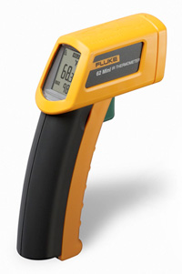
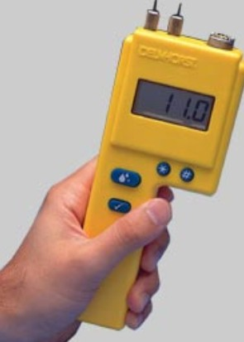
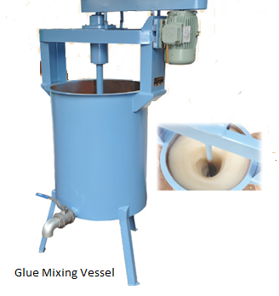
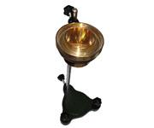
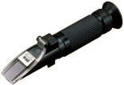
14 Dec 2013
‹#›

Slide 14


Thank You
STARDEX
stardex@vsnl.net
Tele: 040 – 23060334 Fax: 040 - 23061638
www.stardex.in
14 Dec 2013
‹#›
Notes:
‹#›

